Slide 1
MODULE 7 – INTRODUCTION TO Arduino boards
Dr. P. Nirmala
Assistant Professor, Sr. Gr. I,
SENSE,
VIT Chennai Campus.

Slide 2
Introduction to microcontrollers
A microcontroller is an electronic device that belongs to the microcomputing family.
They are fabricated using VLSI technology on a single chip.
Components – memory, peripherals and processor
Any gadget or instrument that has to perform calculation, control, measure, display, consists of a microcontroller chip
Present in almost all present day appliances from toys to traffic light signals.

Slide 3
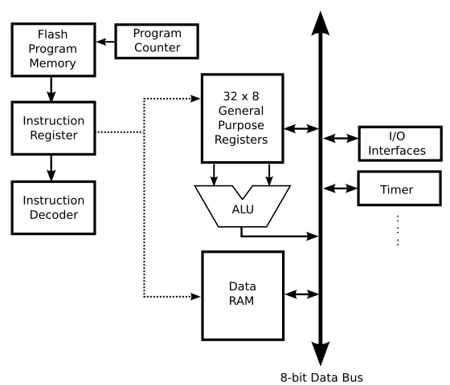
Microcontroller architecture
Source: https://ccrma.stanford.edu/wiki/Microcontroller_Architecture as on 08 Oct 2020

Slide 4
Continued…
Most important part of microcontroller is CPU.
Word length ranges from 4 bit to 64 bits
A timer and watchdog timer are present
Memory space such as RAM, ROM, EPROM, EEPROM are present

Slide 5
Functions of each block
CPU – fetches decodes and executes instructions
I/O ports – to interface various peripherals such as printer, external memories, LEDs and LCDs.
Memory – RAM, ROM, EPROM, EEPROM. Also has flash memory to store program source code
Timers and counters – For processes like modulation, clock functions, frequency generation and measuring, pulse generation.
ADCs
DACs

Slide 6
features
CISC architecture is used in modern microcontrollers – macro type instructions
Lesser power consumption, working voltage is 1.8 – 5.5 volts
Advanced memory – use of ROM such as EPROM and EEPROM makes it user friendly
EPROM is faster – easy and faster erase/write cycles

Slide 7
Advantages
Low cost with all integral parts mounted on a single chip
More compact and easy to use
Easy maintenance and hence more reliable
All pins in a microcontroller are programmable and hence user friendly
Simple while interfacing RAM, ROM, I/O devices etc
Easiness in troubleshooting

Slide 8
disadvantages
All components on a single chip – so complex architecture
Cannot interface high power devices directly
They can only perform limited number of operations simultaneously

Slide 9
Difference between microprocessor and microcontroller
Microprocessor | Microcontroller
It has only the processor. Designer has to add them separately | It has processor, memory unit and other peripheral devices embedded
Applications are where the tasks are unspecific, e.g, developing software, games, websites etc. | Designed to perform specific tasks where relationship between the input and output is designed
System with microprocessors are costlier | Cheaper
Can operate above 1 GHz | Clock speed is from 30 – 50 MHz
Eg., Laptops, notepads etc. | ATMEL, Microchip, TI, Philips, Motorola etc.

Slide 10
8051 microcontroller
Introduced by Intel in 1981
40 kB internal ROM and 128 byte RAM
68 kB of external memory can be interfaced
Four parallel 8-bit ports
Crystal oscillator is present that creates a clock frequency of 12 MHz
Serial port – 8 bit size
Two 16 bit timers

Slide 11
Applications of 8051
Robotics
Bio-medical equipment
Communication systems
Automobiles
Fire detection devices
Light and temperature sensing devices
Industrial automation devices etc.

Slide 12
Weblink
https://openlabpro.com/guide/basics-of-microcontroller/#:~:text=A%20microcontroller%20is%20an%20electronic,64%20bit%20to%20128%20bit.

